Slide 1
Presentation of heredity
Presented by shailaj adhikari

Slide 2
Introduction
Heredity is the mechanism by which characteristics, resemblances, and differences are passed down from one generation to the next. Gene is the unit of heredity. Genetics is the study of heredity in biology. Gregor Mendel proposed the laws of inheritance.

Slide 3
Cell division
Cell division is the process by which a parent cell divides into two daughter cells. Cell division usually occurs as part of a larger cell cycle in which the cell grows and replicates its chromosome before dividing. The major steps of cell division are:
Interkinesis(resting phase in between two successive cell divison)
Karyokinesis(divison of nucleus)
Cytokinesis(division of cytoplasm)

Slide 4
Mitosis cell division
Mitosis is a process of nuclear division in eukaryotic cells that occurs when a parent cell divides to produce two identical daughter cells. During cell division, mitosis refers specifically to the separation of the duplicated genetic material carried in the nucleus. This cell division completes in these different process.
interphase or interkinesis
Karyokinesis
cytokinesis

Slide 5
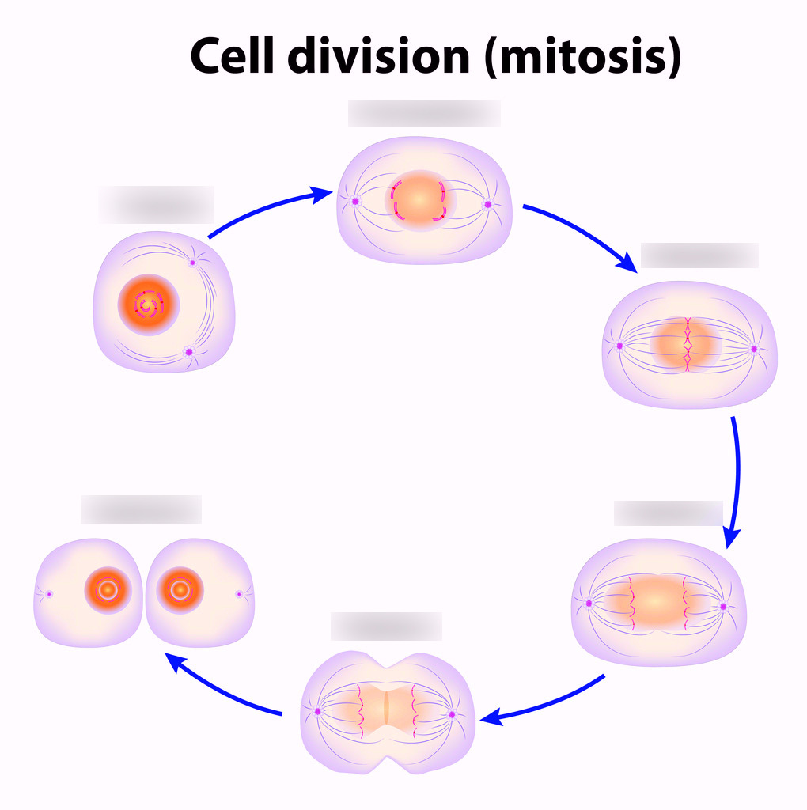
Interphase or interkinesis
Interkinesis, also known as interphase II, is a period of rest that certain species’ cells experience between meiosis I and meiosis II. During interkinesis, no DNA replication occurs; nevertheless, replication occurs during the interphase I stage of meiosis.

Slide 6
Karyokinesis
During mitosis or meiosis, the process of karyokinesis is the division of cell nucleus. It is succeeded by cytokinesis, which is the splitting of the cytoplasm and cell membrane. Karyokinesis is the process of dividing a cell’s nucleus to from to nuclei for the two daughter cells during cell division.it completes in four stage prophase, metaphase, anaphase, telophase.

Slide 7
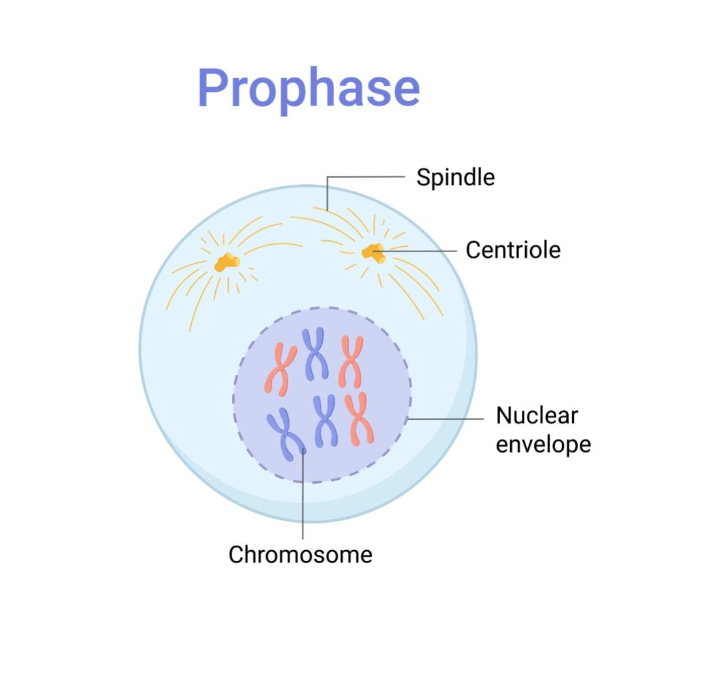
Prophase
Prophase is the first stage of cell division in both mitosis and meiosis. Beginning after interphase, DNA has already been replicated when the cell enters prophase. The main occurrences in prophase are the condensation of the chromatin reticulum and the disappearance of the nucleolus.

Slide 8
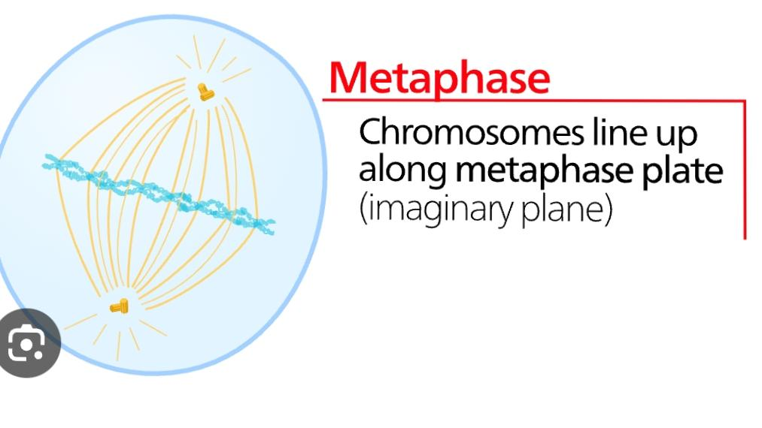
Metaphase
Metaphase is a stage of mitosis in the eukaryotic cell cycle in which chromosomes are at their second-most condensed and coiled stage. These chromosomes, carrying genetic information, align in the equator of the cell before being separated into each of the two daughter cells.

Slide 9
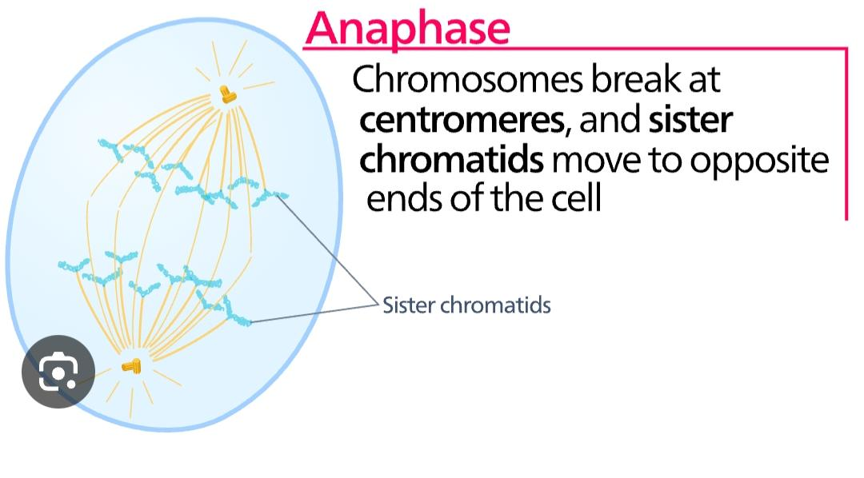
Anaphase
Anaphase is the stage of mitosis after the process of metaphase, when replicated chromosomes are split and the newly-copied chromosomes are moved to opposite poles of the cell.

Slide 10
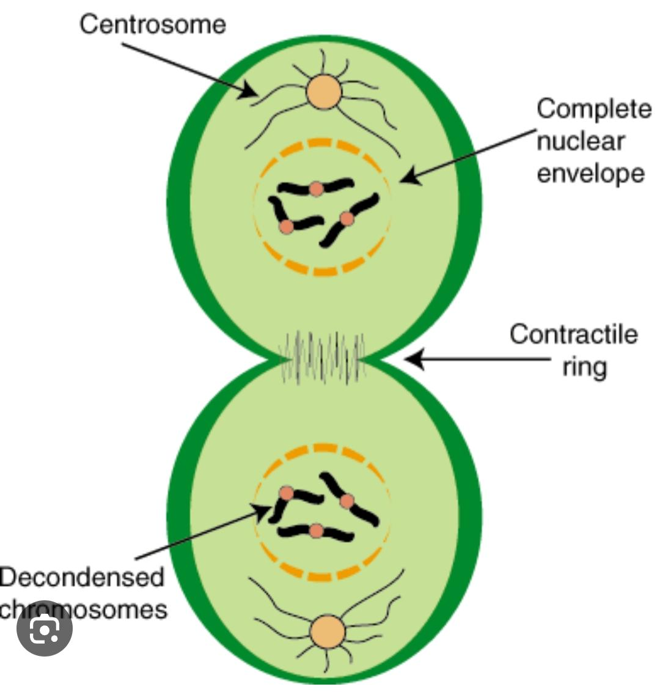
Telophase
During telophase, a nuclear membrane forms around each set of chromosomes to separate the nuclear DNA from the cytoplasm. The chromosomes begin to uncoil, which makes them diffuse and less compact.

Slide 11
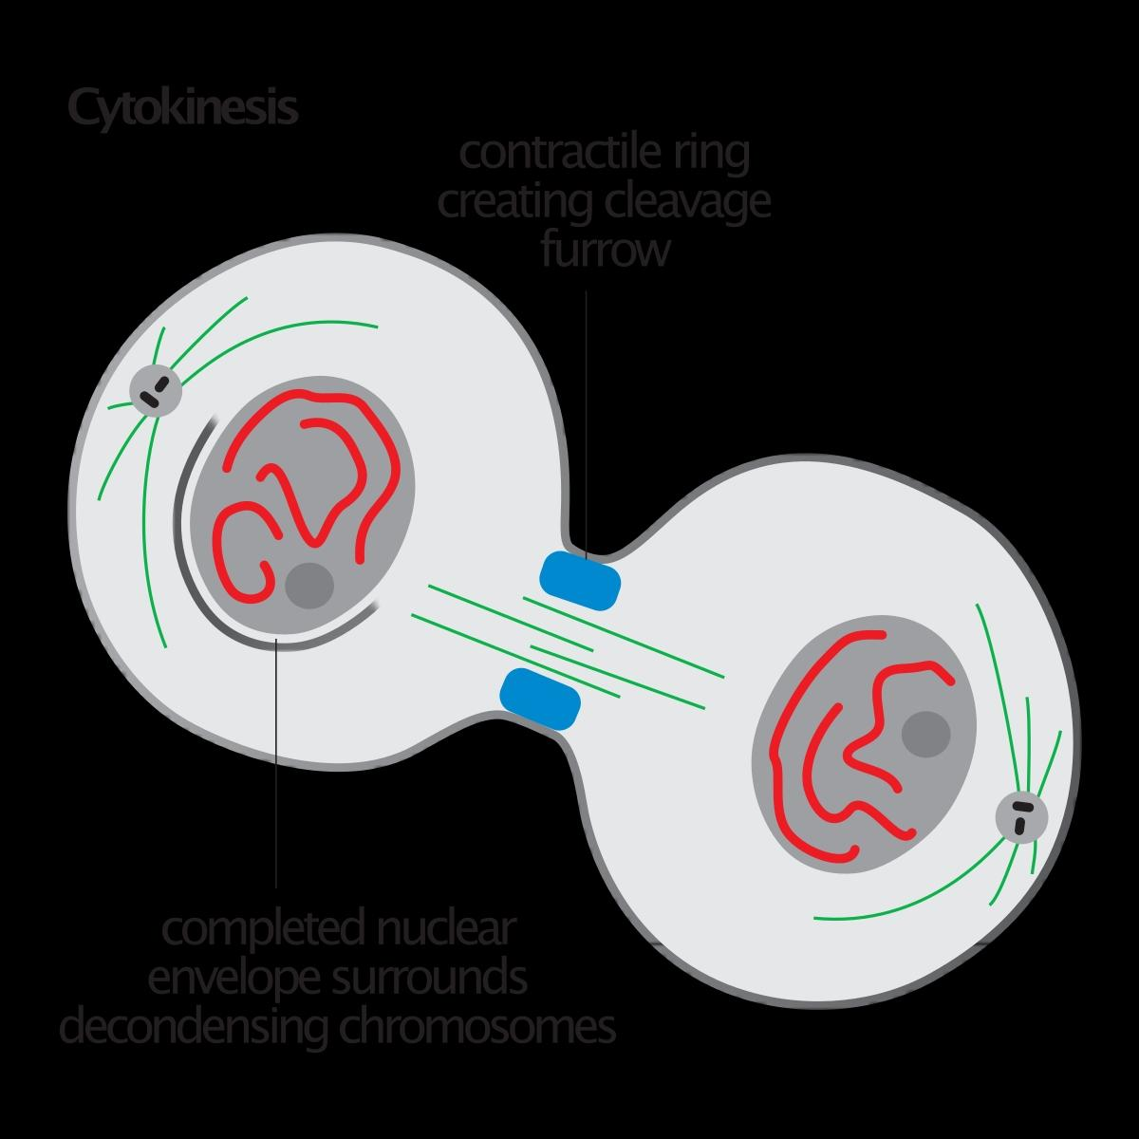
Cytokinesis
Cytokinesis is the part of the cell division process during which the cytoplasm of a single eukaryotic cell divides into two daughter cells. Cytoplasmic division begins during or after the late stages of nuclear division in mitosis and meiosis.

Slide 12
Significance of mitosis cell division.
1)mitosis cell division is essential for growth and development of multicellular organisms.
2)the number of chromosomes in the daughter cells remains equal to the number of chromosomes in their mother cells.
Mitosis helps in asexual reproduction like budding.

Slide 13
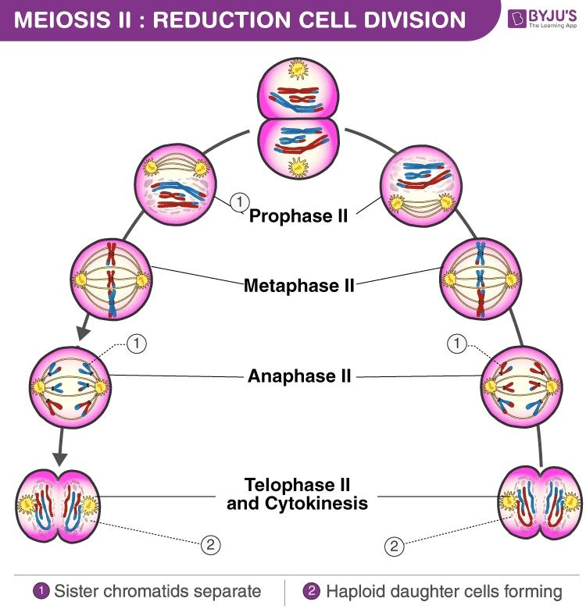
Meiosis cell division
Meiosis is a type of cell division that reduces the number of chromosomes in the parent cell by half and produces four gamete cells. This process is required to produce egg and sperm cells for sexual reproduction.

Slide 14
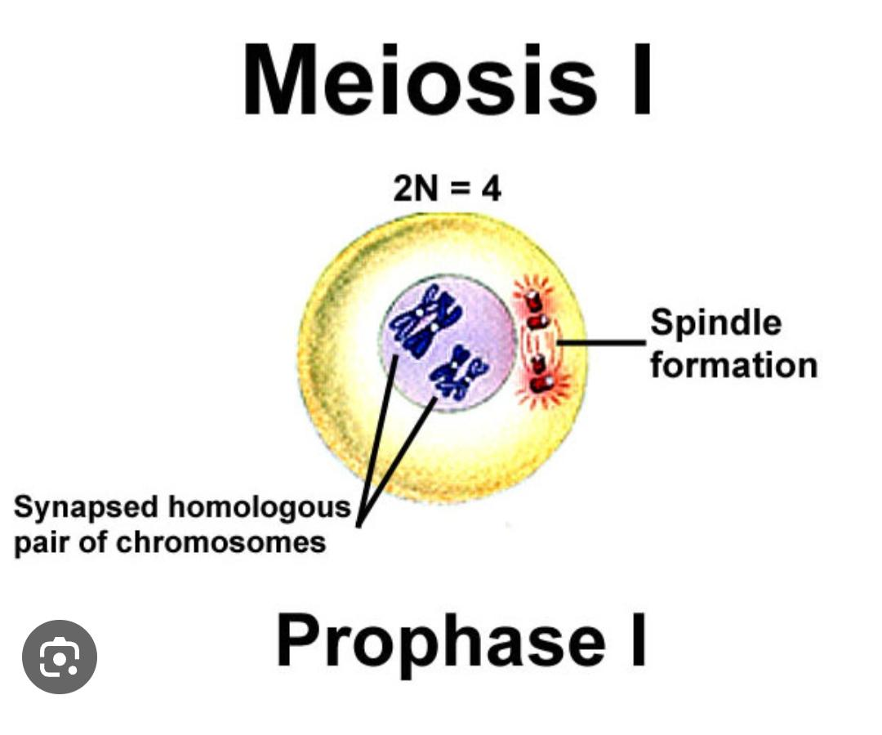
Prophase i
During prophase I, the complex of DNA and protein known as chromatin condenses to form chromosomes. The pairs of replicated chromosomes are known as sister chromatids, and they remain joined at a central point called the centromere.

Slide 15
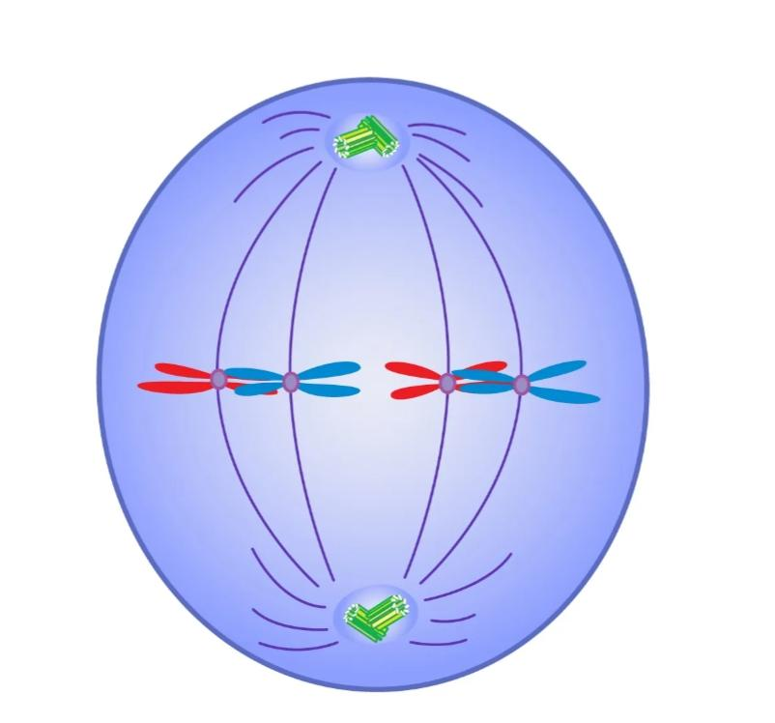
Metaphase I
Metaphase is a stage during the process of cell division (mitosis or meiosis). Normally, individual chromosomes are spread out in the cell nucleus. During metaphase, the nucleus dissolves and the cell’s chromosomes condense and move together, aligning in the center of the dividing cell.

Slide 16
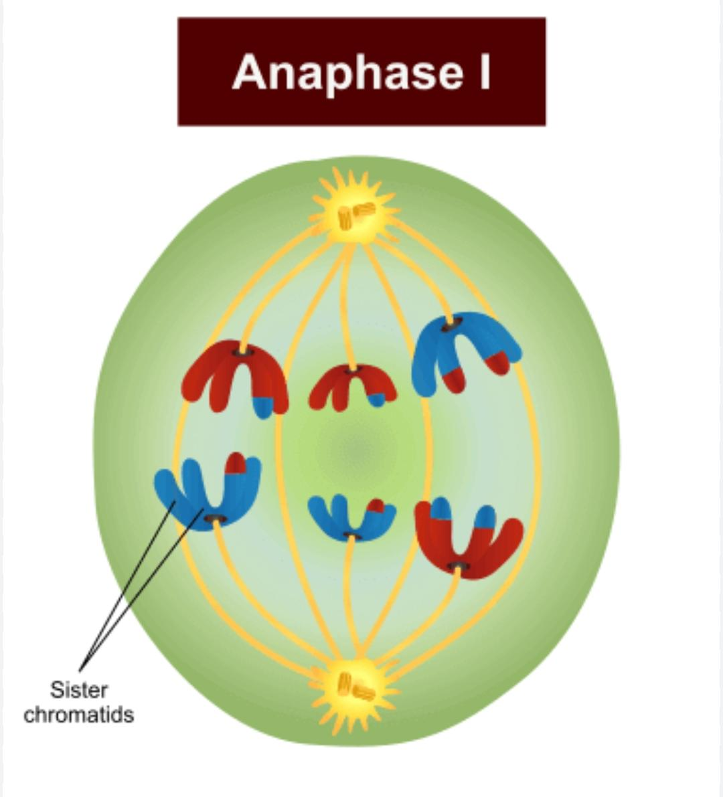
Anaphase I
Anaphase I begins when homologous chromosomes separate. The nuclear envelope reforms and nucleoli reappear. The chromosomes coil up, the nuclear membrane begins to disintegrate, and the centrosomes begin moving apart. Spindle fibers form and sister chromatids align to the equator of the cell.

Slide 17
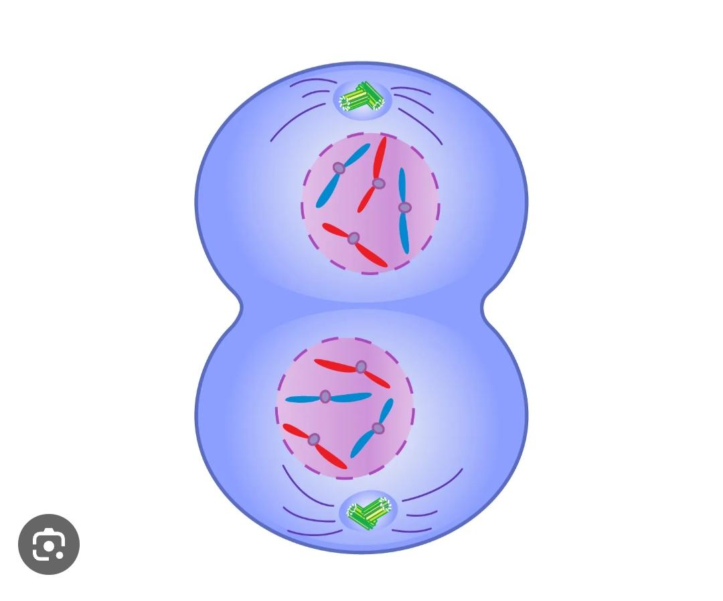
Telophase I
During telophase I, the chromosomes are enclosed in nuclei. The cell now undergoes a process called cytokinesis that divides the cytoplasm of the original cell into two daughter cells. Each daughter cell is haploid and has only one set of chromosomes, or half the total number of chromosomes of the original cell.

Slide 18
Significance of meiosis
Meiosis maintains a definite and constant number of chromosomes into daughter cells exactly equal as the mother cell
It causes the genetic variation among the species
It has a role in evolution
It helps to form a haploid gametes or spores which are essential in reproduction

Slide 19
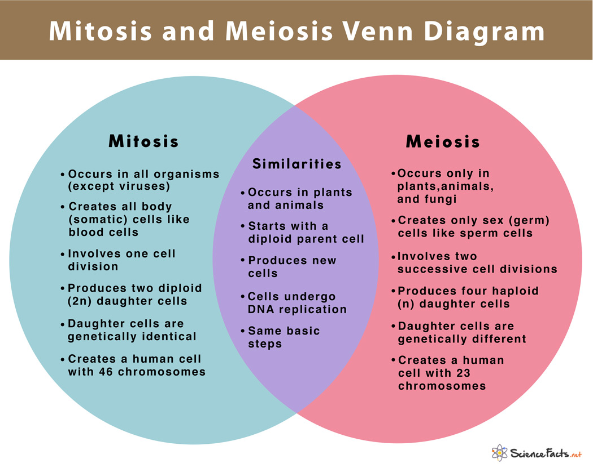

Slide 20
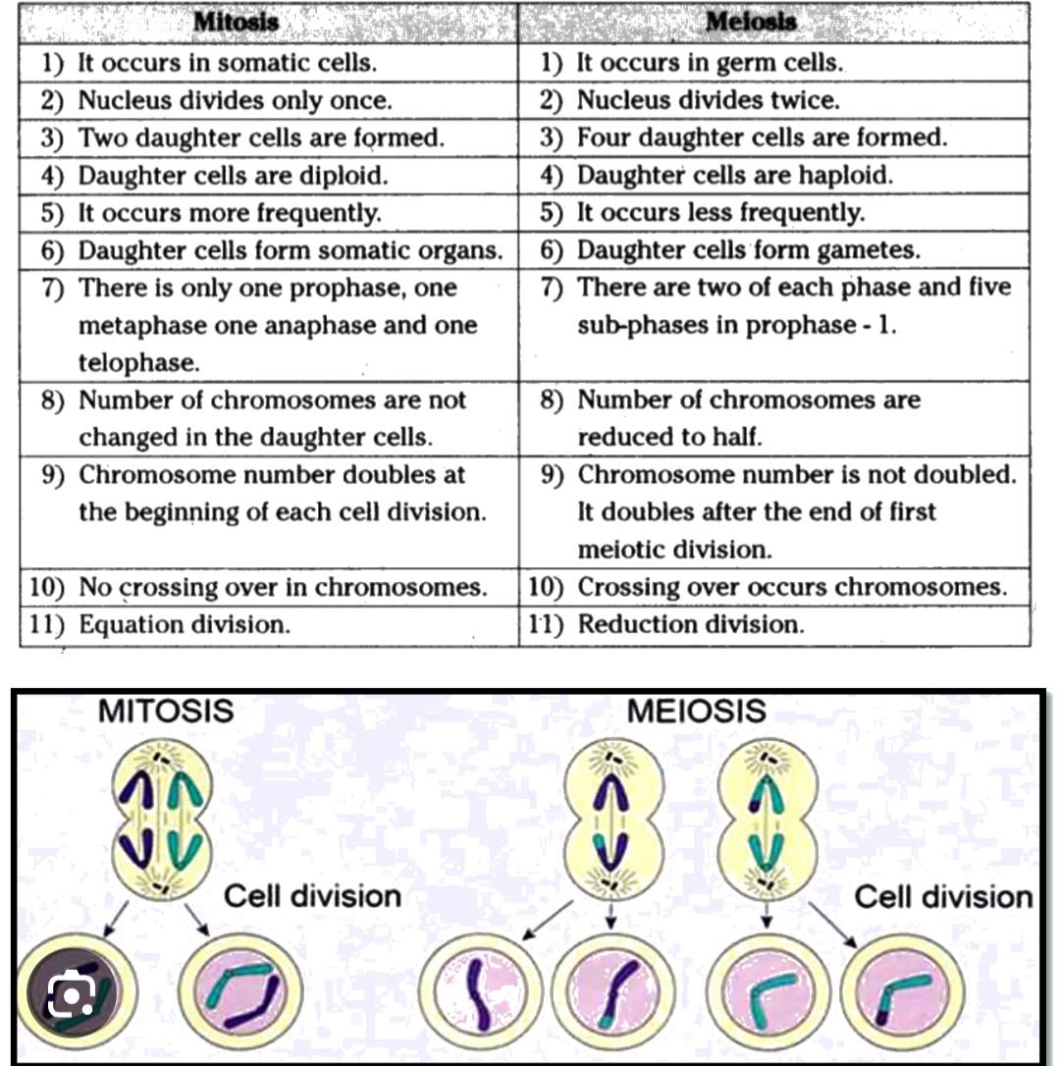

Slide 21
Chromosome
Chromosomes are thread-like structures located inside the nucleus of animal and plant cells. Each chromosome is made of protein and a single molecule of deoxyribonucleic acid (DNA). Passed from parents to offspring, DNA contains the specific instructions that make each type of living creature unique.

Slide 22
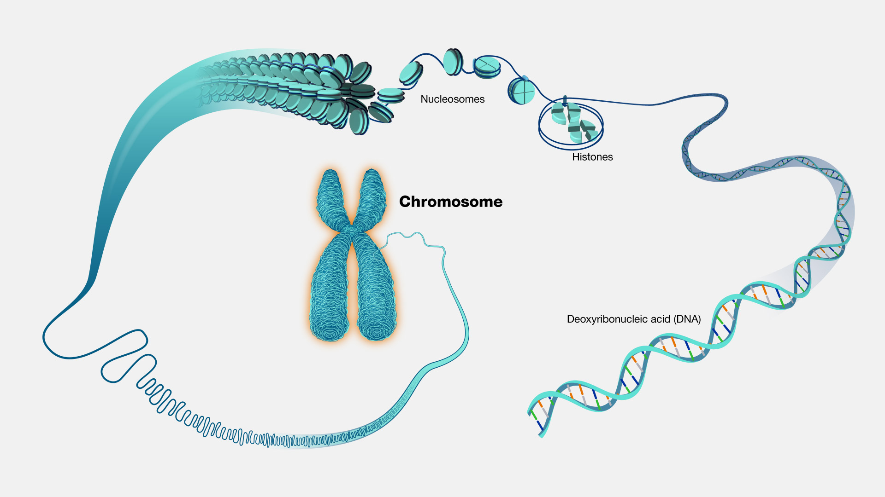

Slide 23
Nucleic acid
Nucleic acids are biopolymers, macromolecules, essential to all known forms of life. They are composed of nucleotides, which are the monomer components: a 5-carbon sugar, a phosphate group and a nitrogenous base. The two main classes of nucleic acids are deoxyribonucleic acid and ribonucleic acid

Slide 24
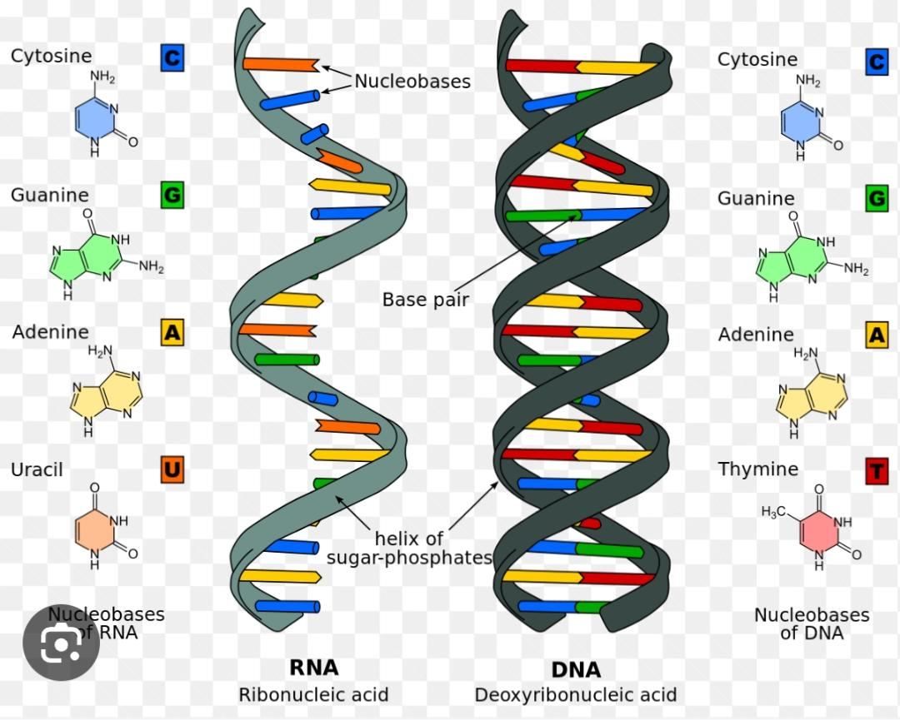

Slide 25
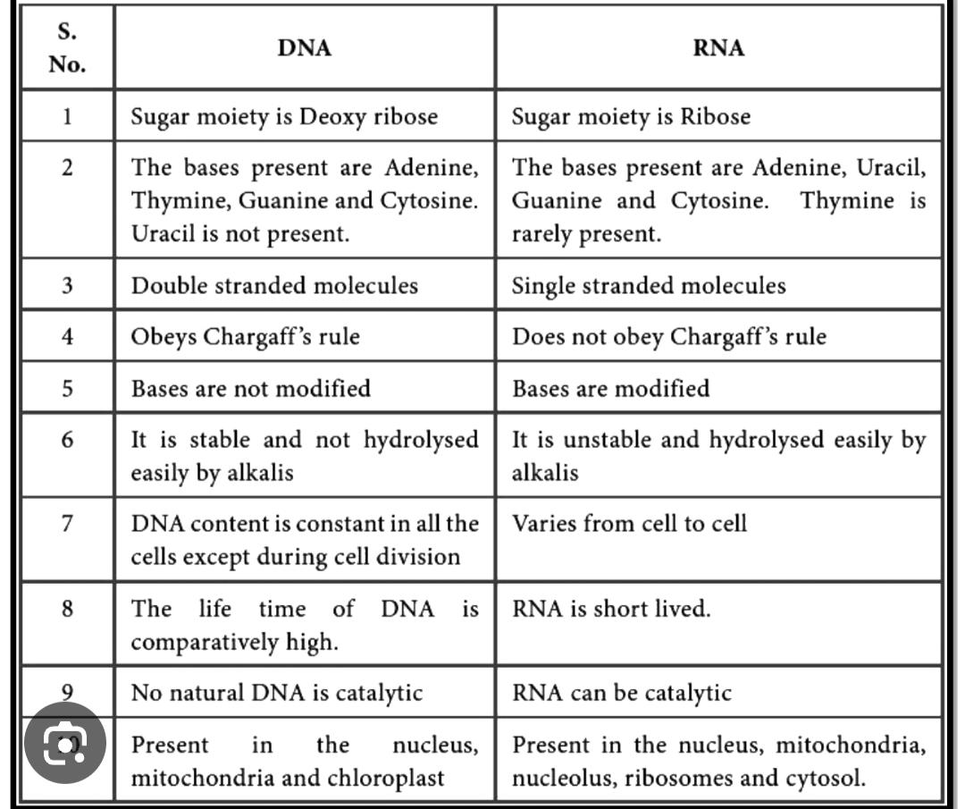

Slide 26
Structure of chromosomes.
Chromosomes are composed of DNA and proteins packed tightly to form long chromatin fibers. Chromosomes house genes responsible for the inheritance of traits and guidance of life processes. Chromosome structure consists of a long arm region and a short arm region connected at a central region known as a centromere.

Slide 27
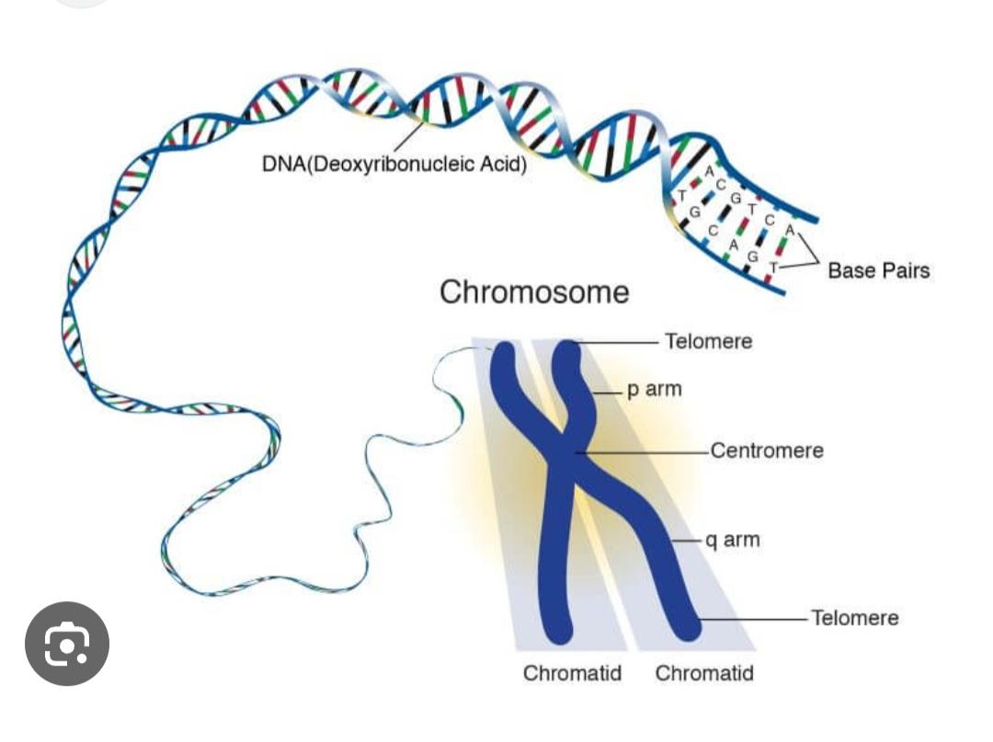

Slide 28
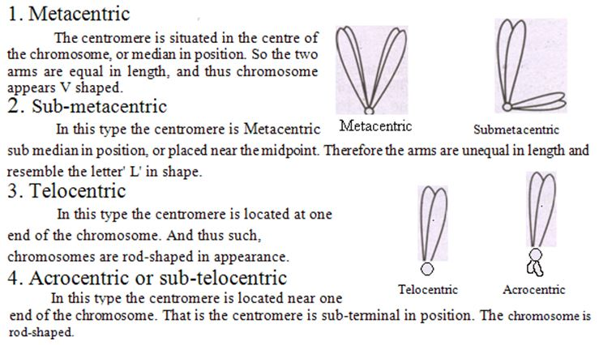

Slide 29
Autosomes and sex chromosomes of humans
An autosome is one of the numbered chromosomes, as opposed to the sex chromosomes. Humans have 22 pairs of autosomes and one pair of sex chromosomes (XX or XY). Autosomes are numbered roughly in relation to their sizes.

Slide 30
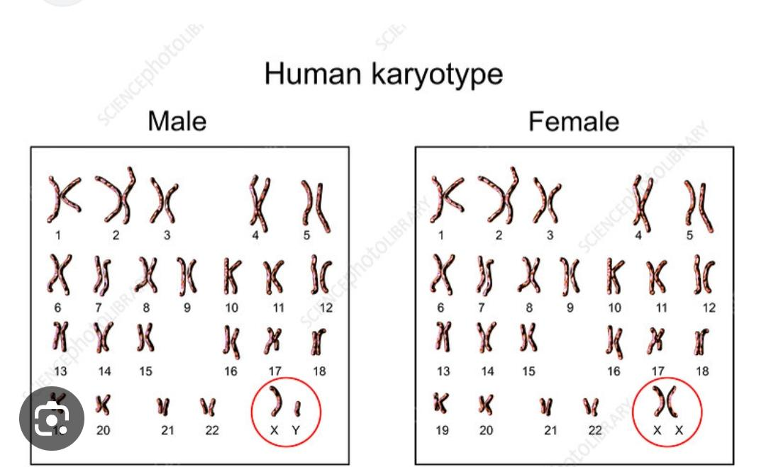

Slide 31
Number of chromosomes in different organisms
Human: 23 pairs
Frog: 13 pairs
Mice: 20 pairs
Onion: 8 pairs
Pea: 7 pairs
Rice: 12
drosophila :8 pairs

Slide 32
More
Potato:14 pairs
Dog:39 pairs
Cow: 30 pairs
Pine: 12 pairs
Housefly: 6 pairs
Gorilla: 24 pairs
Mucor:1pair

Slide 33
Sex determination
A sex-determination system is a biological system that determines the development of sexual characteristics in an organism. Most organisms that create their offspring using sexual reproduction have two common sexes and a few less common intersex variations. In some species there are hermaphrodites.

Slide 34
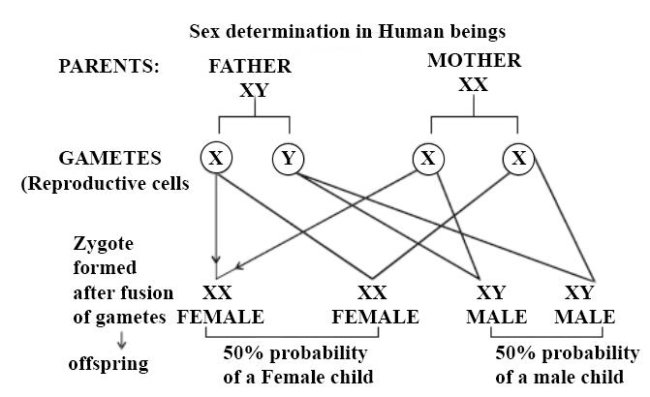
Sex determination in humans
Human beings have XX_XY sex determination system. In this, the males have XY sex chromosomes. They produce two types of gametes having X and Y chromosome. The females have XX chromosome. They produce only one type of gamete having X chromosome. The sex of a child is determined by the type of chromosome he/she receiving from the father. If sperm is having X chromosome, then the child will be a girl. If sperm is having Y chromosome, then the chilld will be a boy. The Y chromosome carries factors responsible for triggering male development. The X chromosome carries factors responsible for triggering female development

Slide 35
Thank you

